Slide 1
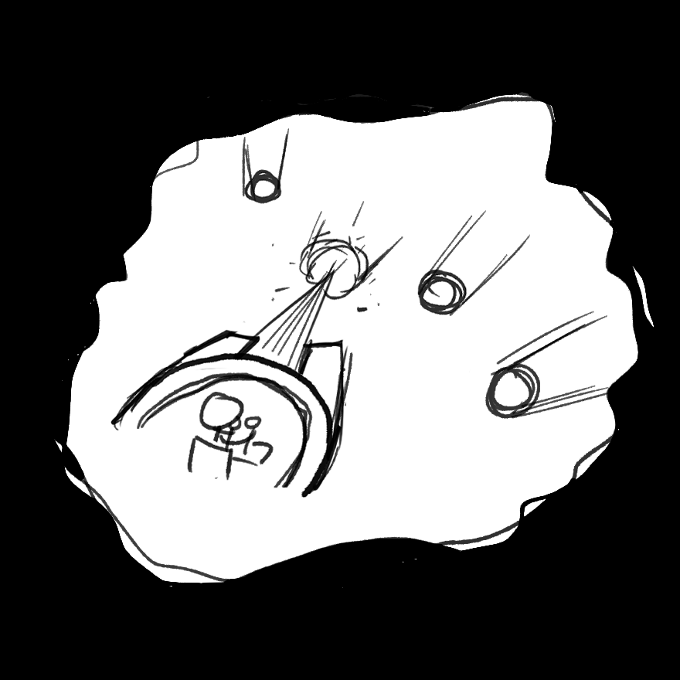
Dank
Team ALICORN
김도윤
김승건
김윤기

Slide 2
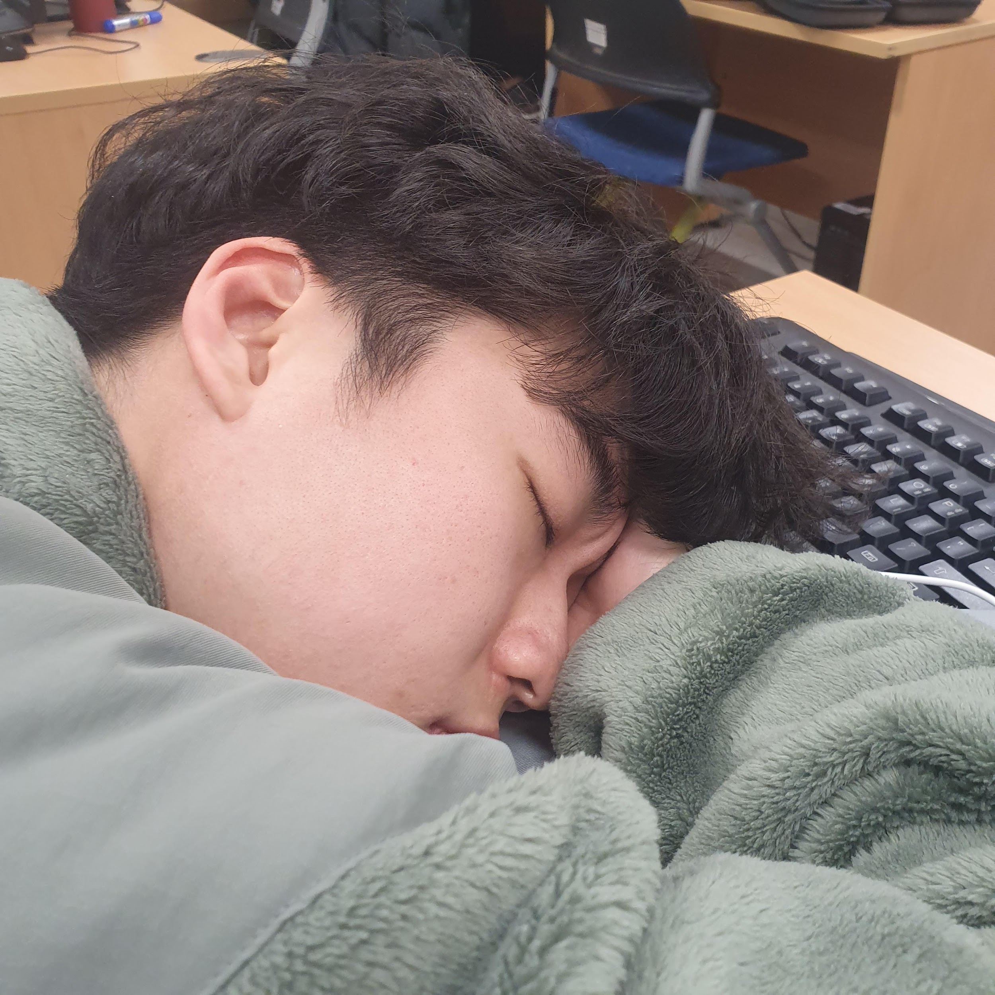
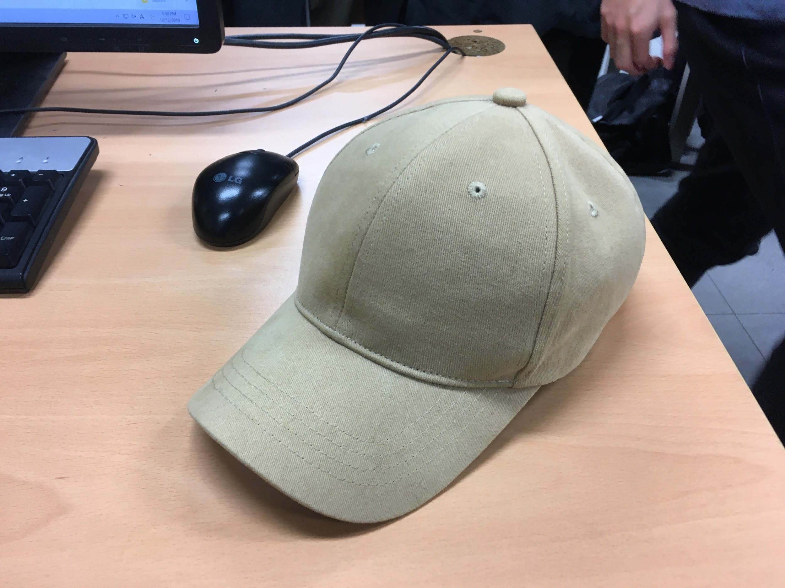
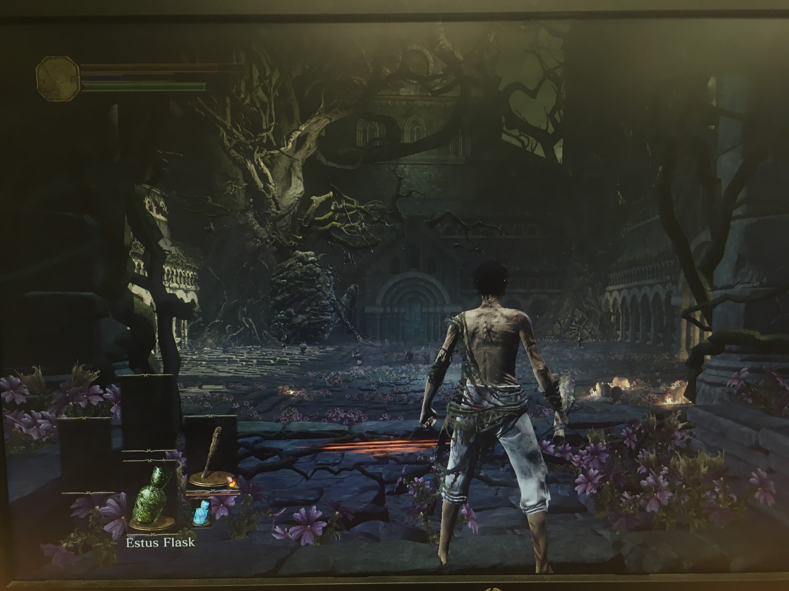
Team ALICORN
YoonKi Kim
Main Programmer
Core loop
Interface flow
Math functions
DoYoon Kim
Level Designer
GameObject
Cannon
Enemies
Level Design
SeungGeon Kim
Designer (poor)
Vector Projection
3D Audio
Scripting
Sound Assets

Slide 3
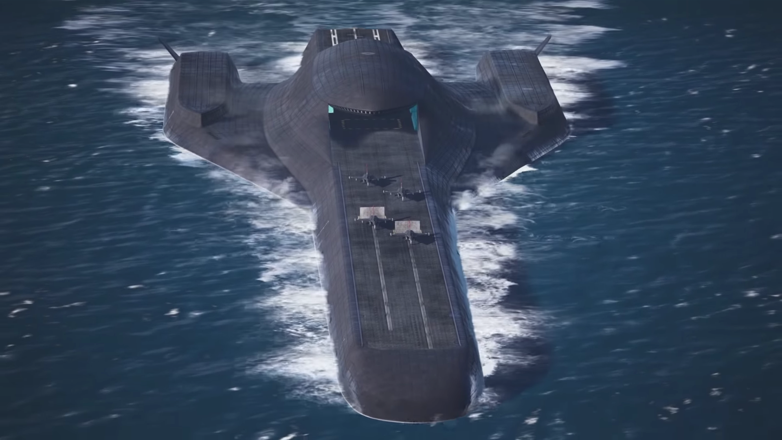
ALICORN ->
Ace Combat 7 by Team Aces (Japan)

Slide 4


Image from SFML homepage / doodle framework documentation

Slide 5
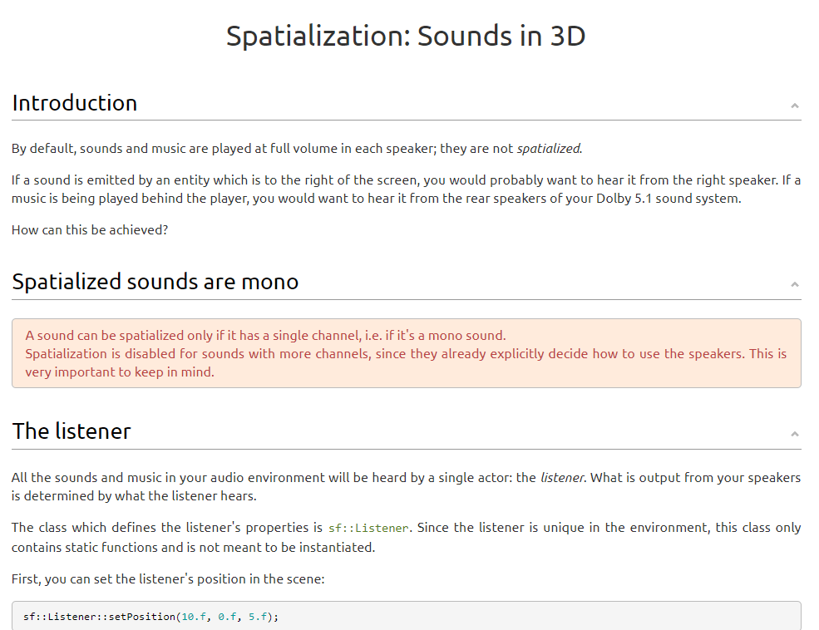

Slide 6
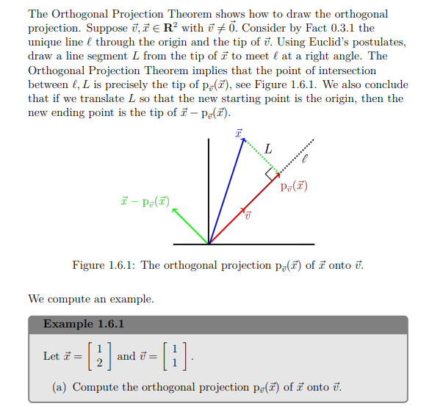
Enemy
Player
Linear Algebra And Geometry by Rosales JR, Leobardo

Slide 7
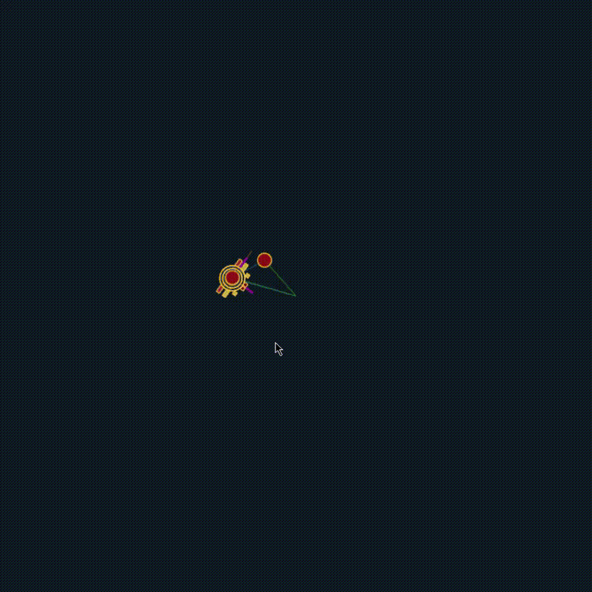
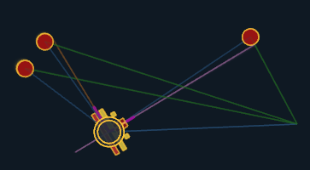
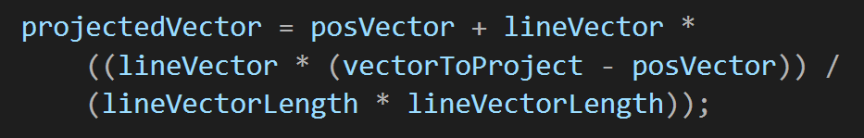
The Projection

Slide 8
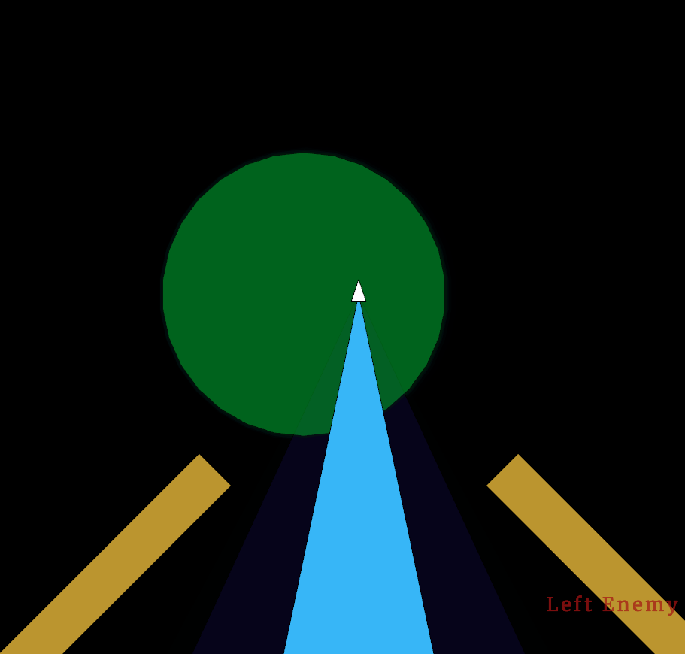
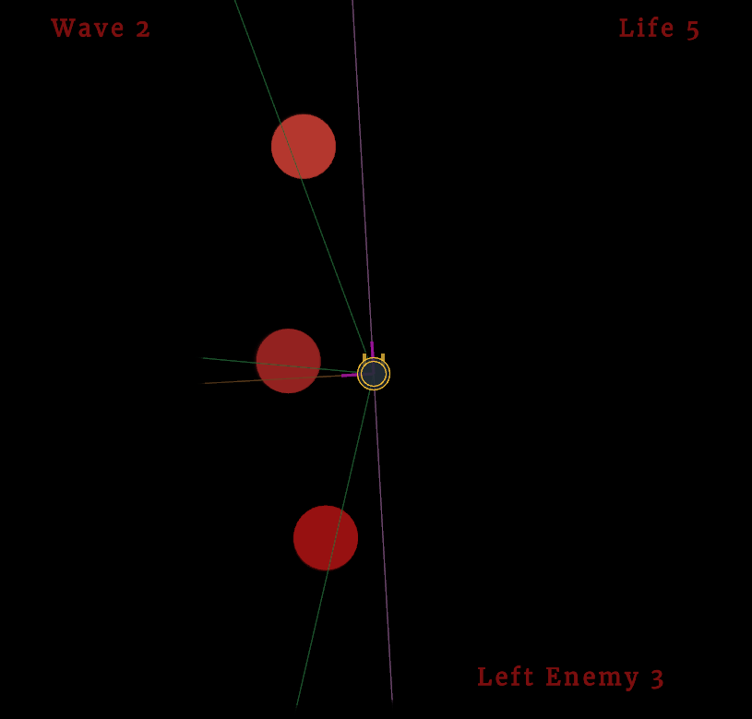
You Hear, you See, then you Shoot.
Different Enemy,
Different Sound
1st person view
3rd person view
You can only see things that’s right in front of you (you cannot see them if it’s far away)
Enemies will be shown here and make a sound once in a set time interval

Slide 9
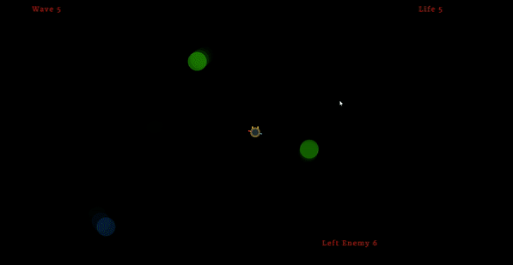
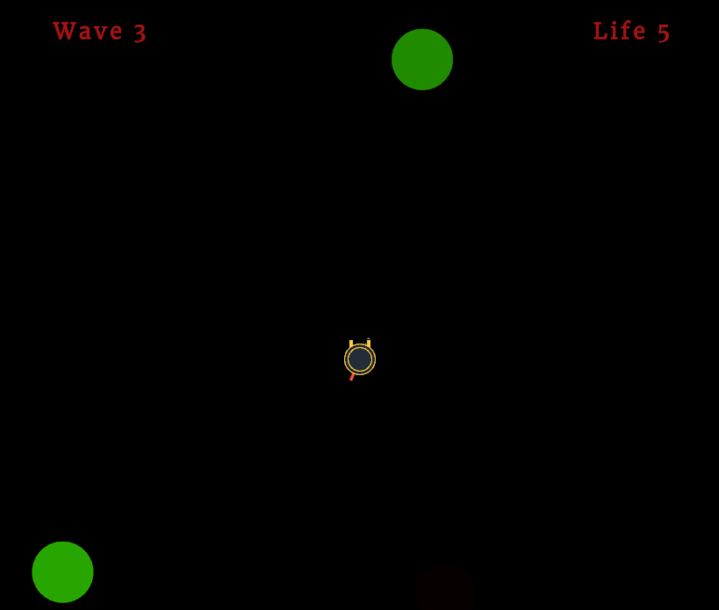

Slide 10
Enemy Types
Basic Enemy
Zigzag Enemy
Warp Enemy
Super-Fast Enemy

Slide 11
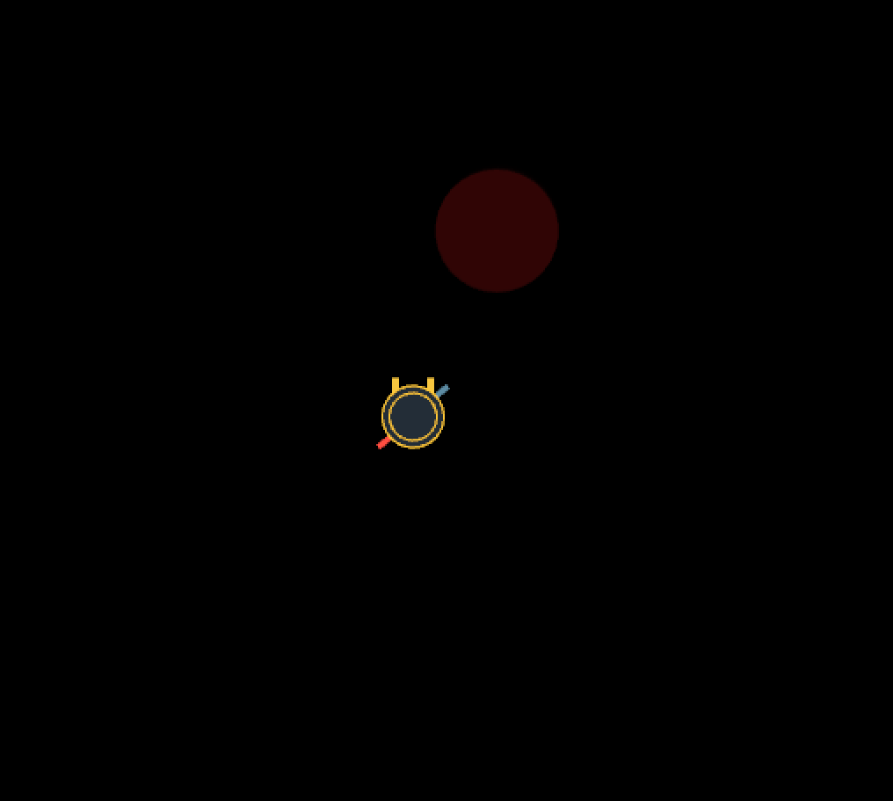
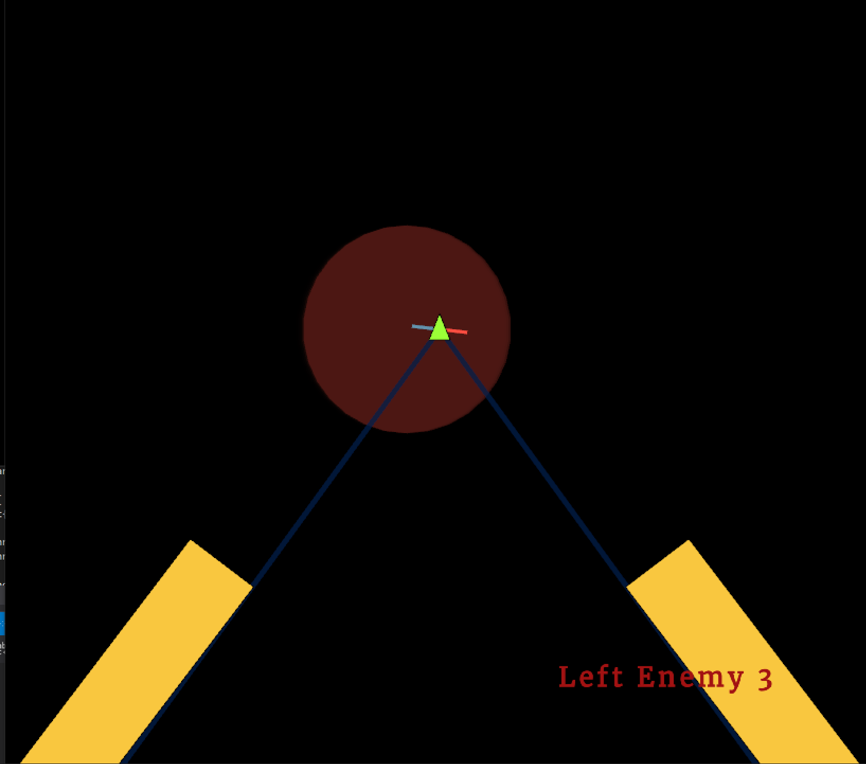
1.Basic Enemy
Notes:
The movement is simple.
It just moves forward to player.
It is the easiest enemy to beat, so it appears at the beginning of the game.

Slide 12
2. Zigzag Enemy
Notes:
This enemy moves forward to player, with zigzag movement.
It consumes player’s time for the most.

Slide 13
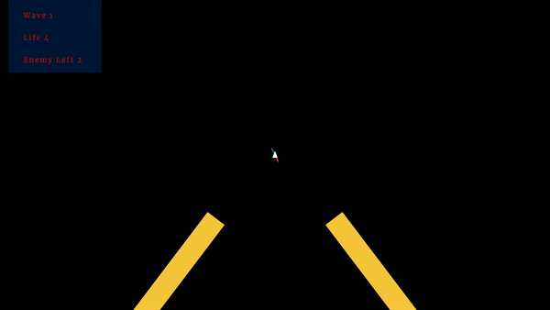
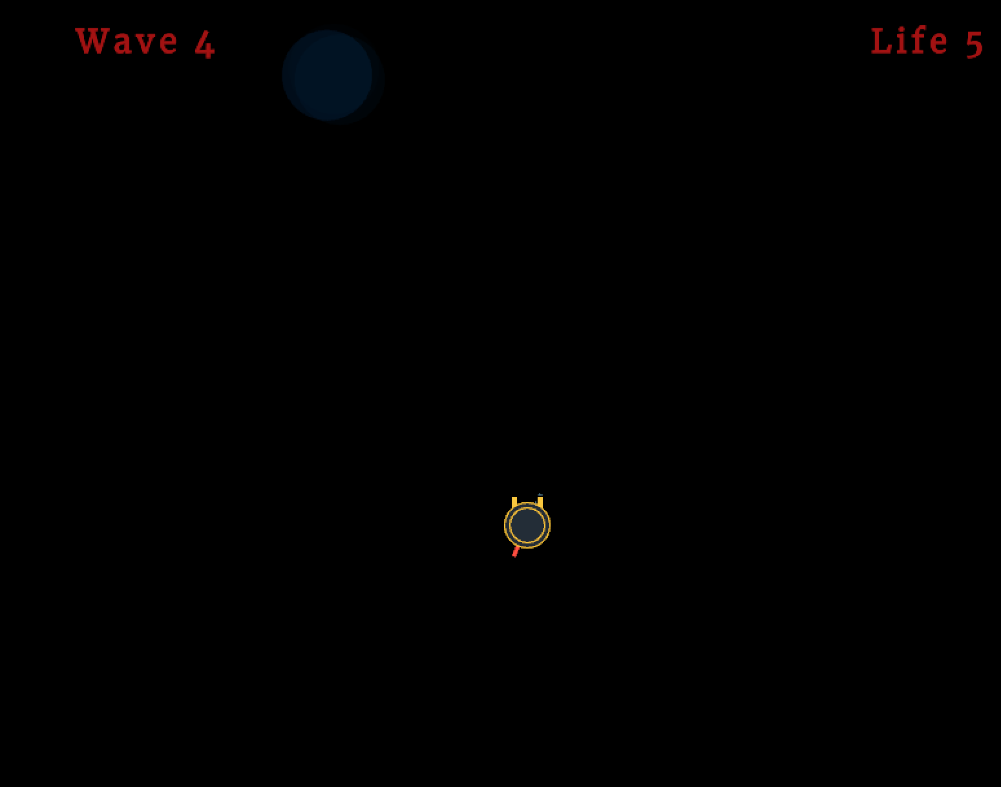
3. Warp Enemy
Notes:
It consistently moves to player, but there is a special movement.
It warps to player in set time interval.
As you can see, it shakes harder as it gets closer to the warp.

Slide 14
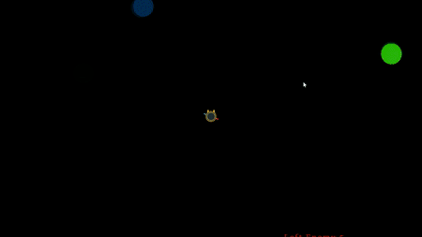
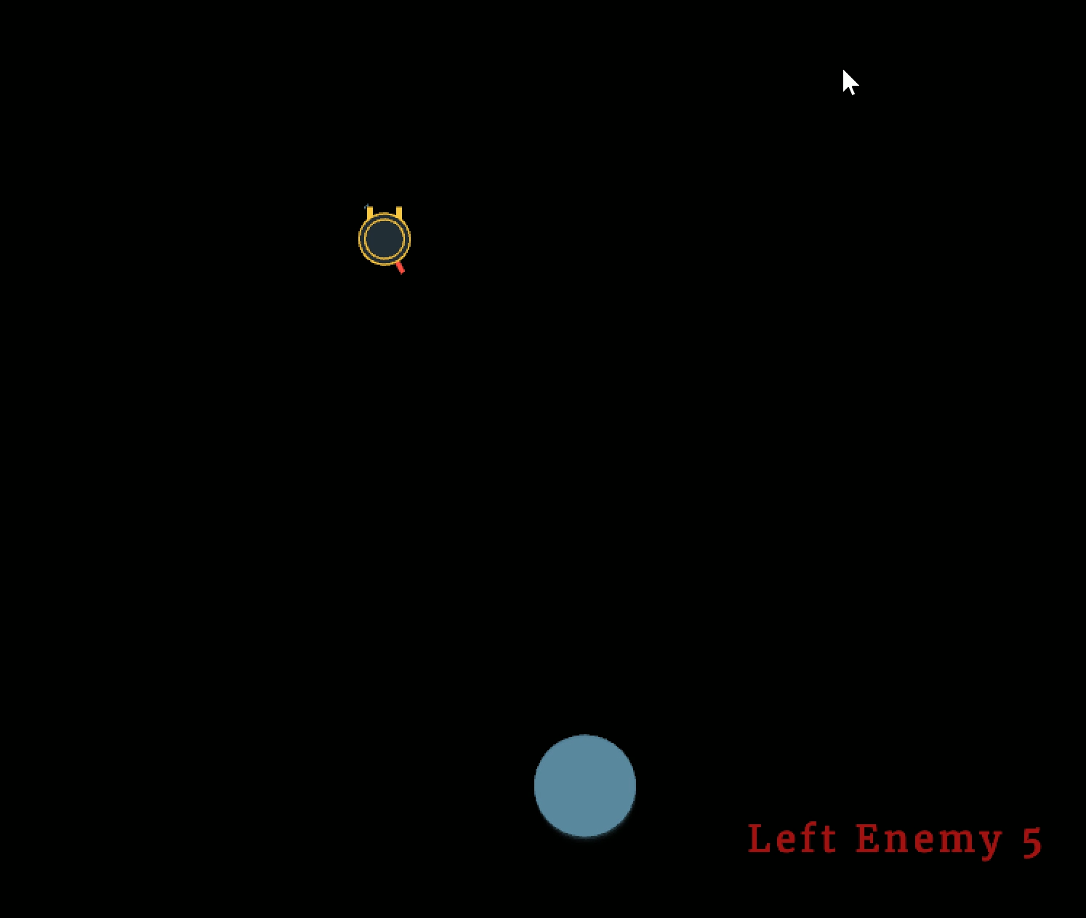
4. Super Fast Enemy
Notes:
It’s movement is same as the basic enemy, but it is super fast.
It makes a unique noise so you can prepare for it before it appears on the screen.

Slide 15
~ Demo Here ~

Slide 16
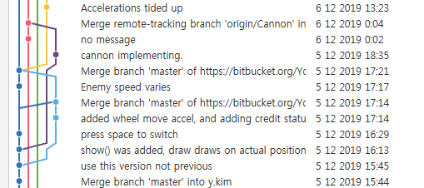
Challenges & Lessons Learned
SeungGeon Kim
Operator overloading is GOOD
Handing out work poorly will end you up with more work to do, and it will affect the teammates’ mentality directly

Slide 17
Challenges & Lessons Learned
YoonKi Kim
Learn more about c++ language
efficiency when using class pointer
can practice using operator overloading
When idea expressed on actual game,
It can be different from our thought
How to make player movement better (by using acceleration and Lerp)
Notes:
Frist, Iearn is we used operator overloading to calculate between vector struct, It makes our work much more easier and keep the code simple.
Also I did not know why we have to use pointer rather than reference, During making our game to manage multiple objects came from same base class.
And second, When idea expressed on actual game, It can be different from our thought, 승건 suggest our first idea and we think it sounds quite fun, let’s do this. but after game works it was too hard to let others to know how to play the game.
And sadly now It is hard to find in our version, I learned how to make player movement better.

Slide 18
Challenges & Lessons Learned
DoYoon Kim
Sound is a very useful gameplay element
More you learn, easier your life becomes (especially math)
Notes:
I was impressed how useful the sound is as a gameplay element.
In our game, sounds are very important to the player.
It indicates enemy’s distance and direction to the player.
It also invokes the player’s emotions like anxiety and excitement.
I also felt the importance of math, again.
I could apply the knowledges we learned in linear algebra class to implement the ray-hit check and it was so convenient.
This experience made me want to learn new things.

Slide 19
Fin

